Slide 1
Capstone III 2023
Banking Term Deposit Prediction Analysis
By Chaitra

Slide 2
About the data
The data set is from Kaggle and contains 21 columns and 41188 rows of data
Out of 21 columns , 20 are independent variables regarding the client and one dependent variable signifying if client subscribed to a term deposit or not. Also, the dataset consists of a mix of continuous and categorical variables.
Bank Term Marketing Prediction

Slide 3
Data Categories
Bank Client Data
Age, Job, Education, Loan, Marital Status, Default, Housing
Related with the last contact of the current campaign:
Contact, Month, Day_of_Week, Duration.
Other attributes:
Campaign ,Pdays, Previous, Poutcome
Social and economic context attributes
Emp.var.rate: employment variation rate , Cons.price.idx: consumer price index, consumer confidence index , Nr.employed: number of employees
Output variable (desired target): y - has the client subscribed a term deposit? (binary: 'yes', 'no')

Slide 4
Project Goal
The data contains details of a direct marketing campaign of a Portuguese bank.
The marketing campaign was used to market term deposit to the clients.
Data contains information about client’s Age, Job , personal loans status, details of previous marketing campaigns etc.
The goal of the project is to predict which clients will subscribe for a Term Deposit and which factors are most important in the prediction process.

Slide 5

Method
The project is done using python on google colab
Performed initial data exploration and used z-test to test the null hypotheses

Slide 6
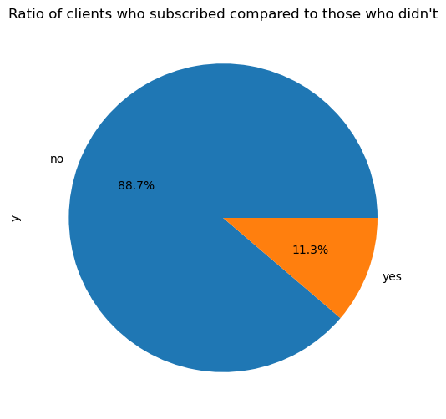
Overall Data
The data contains 41188 client's information.
Among 41188 only 4640(11%) clients have subscribed for term deposit

Slide 7
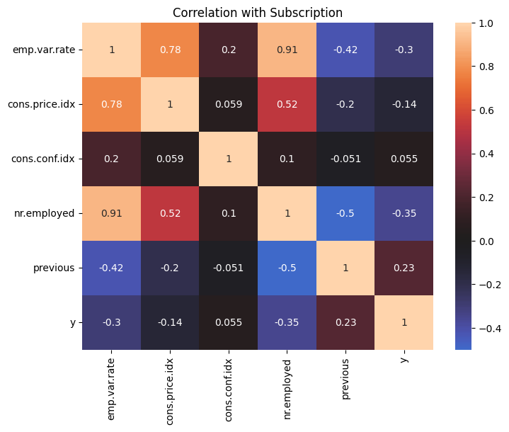
Correlations
Previous: number of contacts performed before this campaign and for this client (numeric) metric is positively correlated to the client subscribing to term deposit

Slide 8
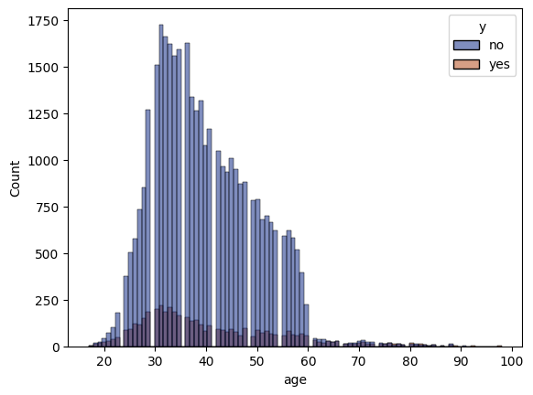
Age vs Term deposit
The above chart shows age distribution of the clients who did and did not subscribe to a term deposit
Most clients close to the Age 35 subscribe to a term deposit

Slide 9
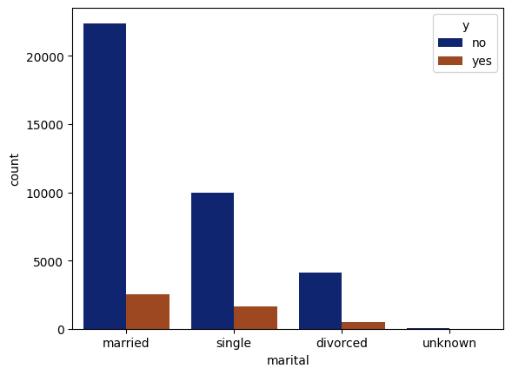
Marital Status vs Term deposit
Married clients contribute to 61% of term deposits. Hence, we can focus on Married people during the campaign

Slide 10
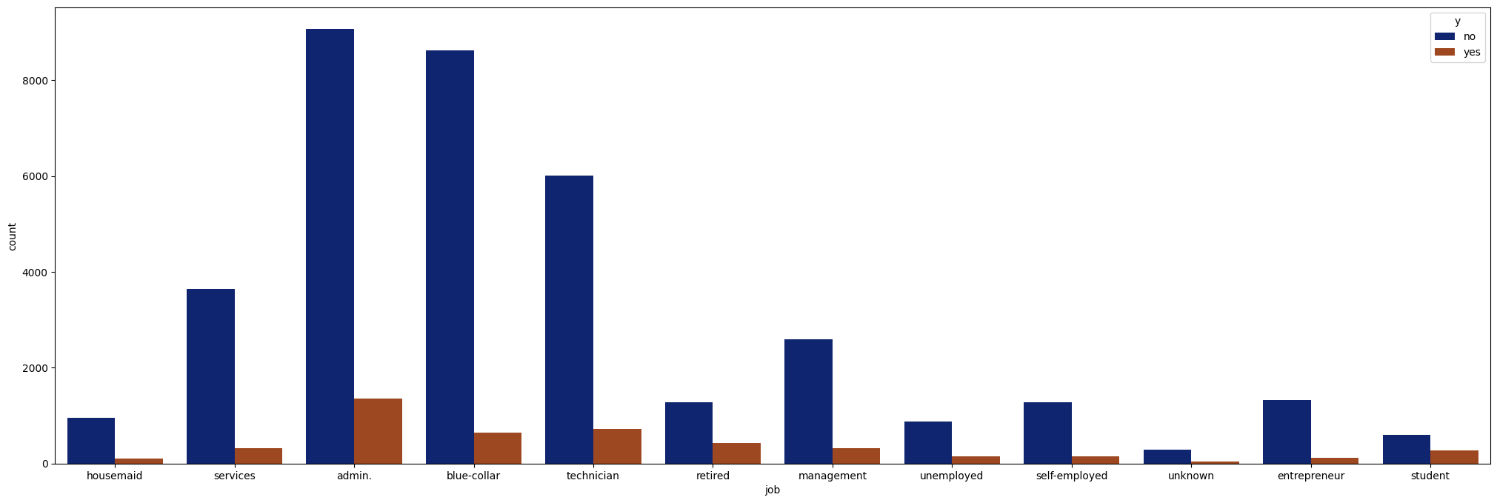
Job type vs Term deposit
Clients in admin, blue collar and technician jobs are more likely to sign up for term deposit

Slide 11
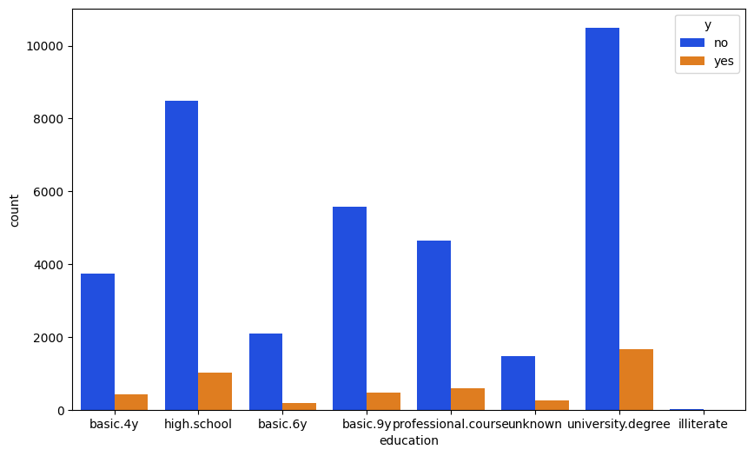
Education Type vs Term deposit
Clients with high school and university degree s are more likely to sign up for term deposit

Slide 12
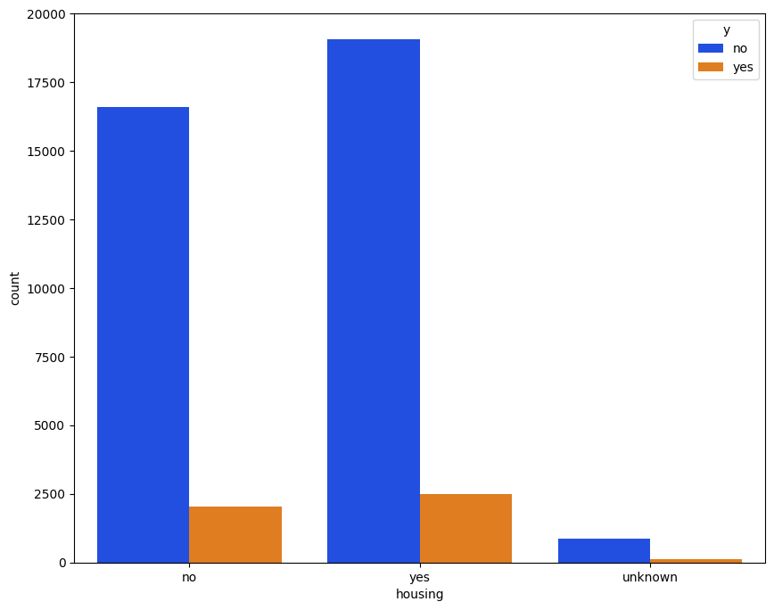
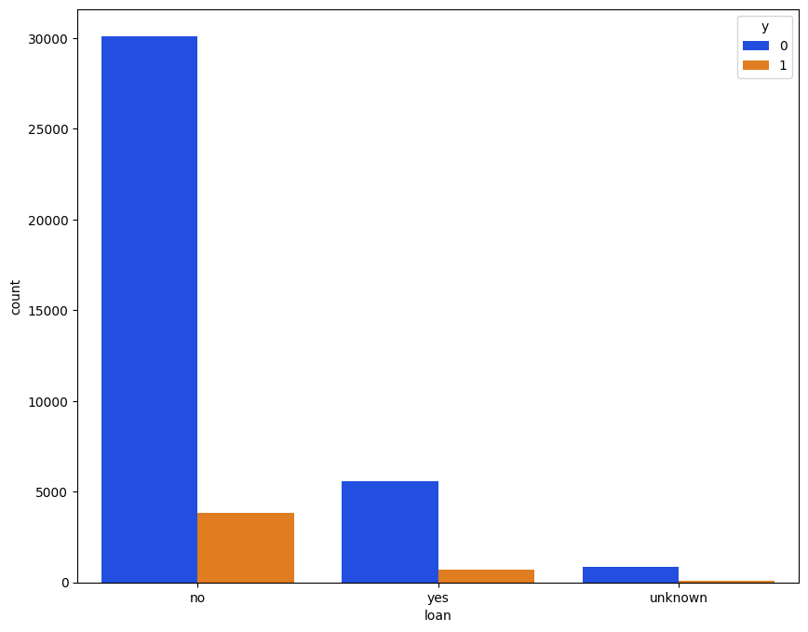
Housing Loan and Personal Loan
People who did not have a personal loan are more likely to buy term deposit
People who having housing loan also tend to subscribe to a term deposit

Slide 13
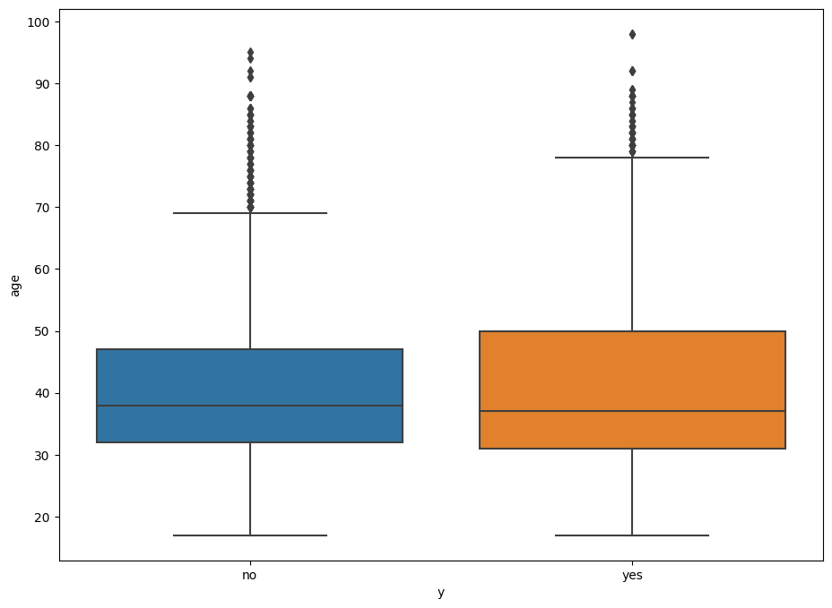
Hypothesis 1
The average age of customers who do not have term deposit is equal to the average age of customer who have term deposit.
Ho : μ_{yes} = μ_{no}
Ha: μ_{yes} <> μ_{no}
z-test results show that for such low p-value we can reject the null hypotheses
Z-Statistics: 6.172087109640128
P-Value: 6.739434944311709e-10

Slide 14
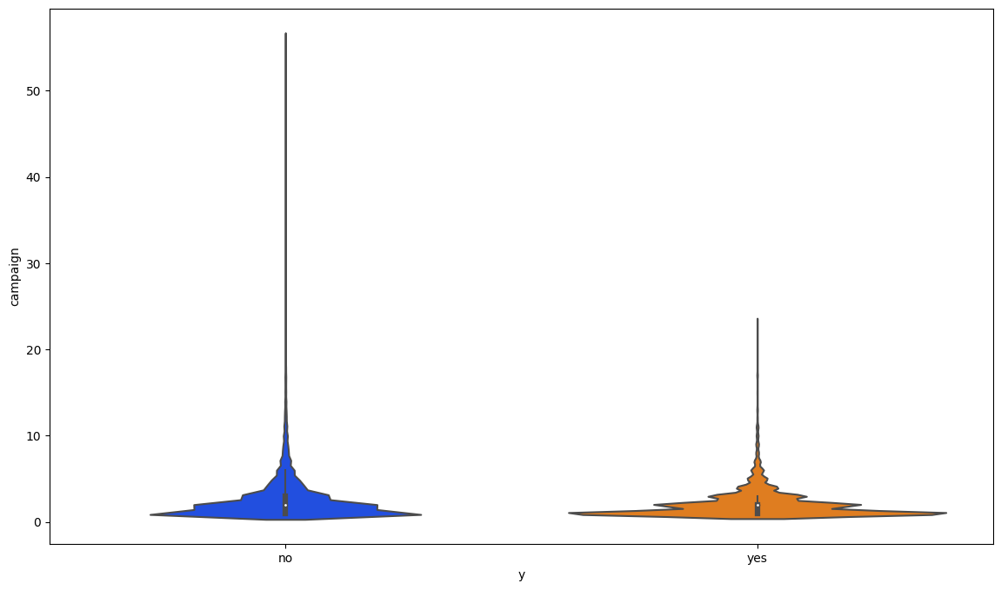
Hypothesis 2
There is impact of number of contacts during the campaign on term deposit or More contact is equal to more customers subscribing to term Deposit
Ho : (avg no of contacts) μ_{yes} = (avg no of contacts) μ_{no}
Ha: μ_{yes} <> μ_{no}
Z-Statistics: -13.496542997299592
P-Value: 1.6388766589153034e-41
z-test results show that for such low p-value we can reject the null hypotheses
This proves that number of contact during the campaign had no significant impact on customer subscribing to the term deposit
Average number of contacts during the campaign for people who bought the term insurance twice

Slide 15
Recommendation
Portuguese Bank should target clients in the following groups to increase term deposit sales
Clients who are age of 30 and above
clients who have a high school or a university degree
Clients who work as Admin, technicians and blue-collar jobs
Clients who are married

Slide 16
Further Research
Building a Prediction Model
Statistical model that will predict the probability of customers subscribing to a term deposit
This help optimize spending for the Portuguese bank

Slide 17

Thank you

